Slide 1
Hi

Slide 2
Everyone

Slide 3

Nice to meet U

Slide 4
Next, U will see

Slide 5
An unforgettable

Slide 6
Game Introduction

Slide 7
Cautious!

Slide 8
Please don't blink

Slide 9
Do not blink

Slide 10
Countdown for 3 seconds

Slide 11
3

Slide 12
2

Slide 13
1

Slide 14
let's go

Slide 15


We are

Slide 16
Group 8

Slide 17
Handsome

Slide 18
Talented

Slide 19
Intelligent

Slide 20
Group 8

Slide 21


Next, I will carefully introduce our members

Slide 22
First of all

Slide 23
Zewen Liang

Slide 24
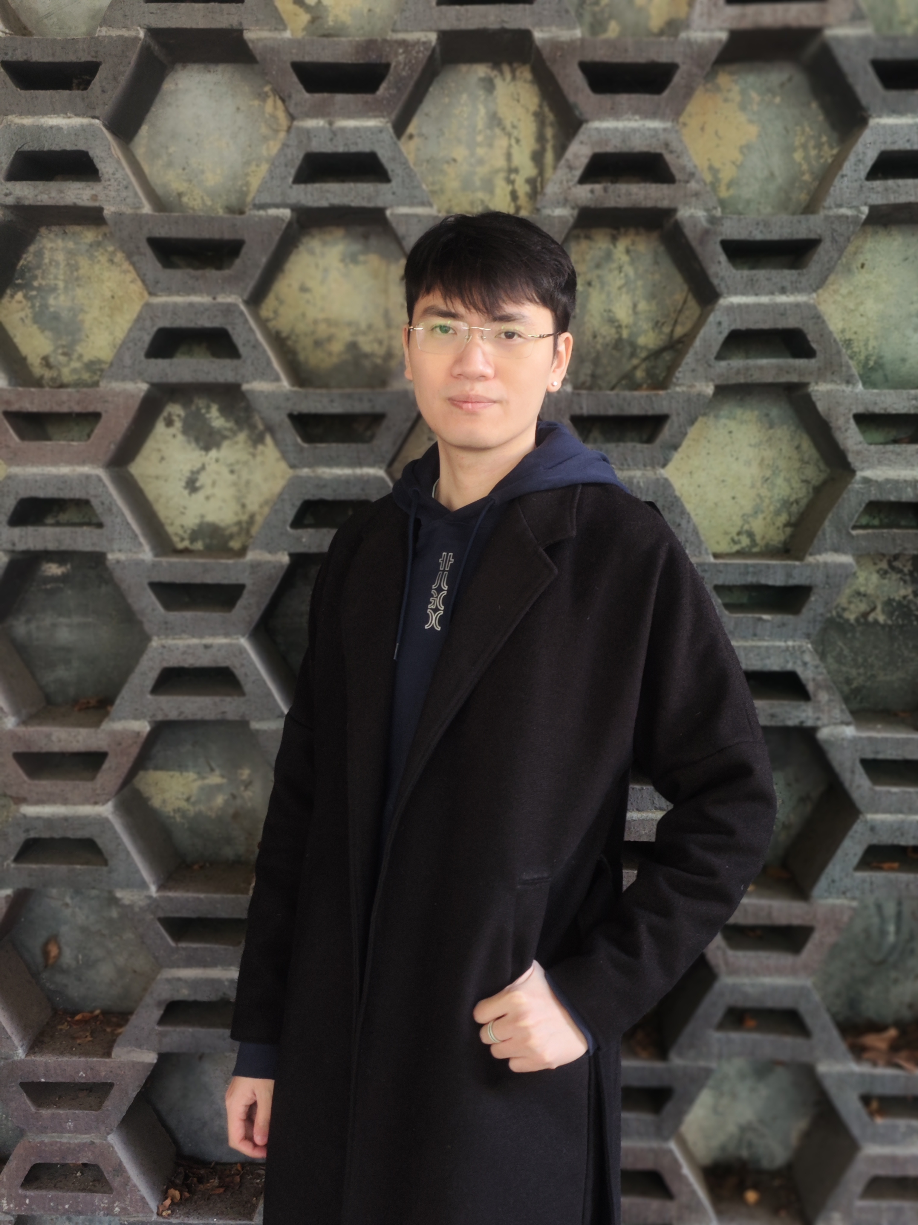

Slide 25
Developer

Slide 26
A synonym for genius

Slide 27
Yunhao Zhou

Slide 28
Next

Slide 29
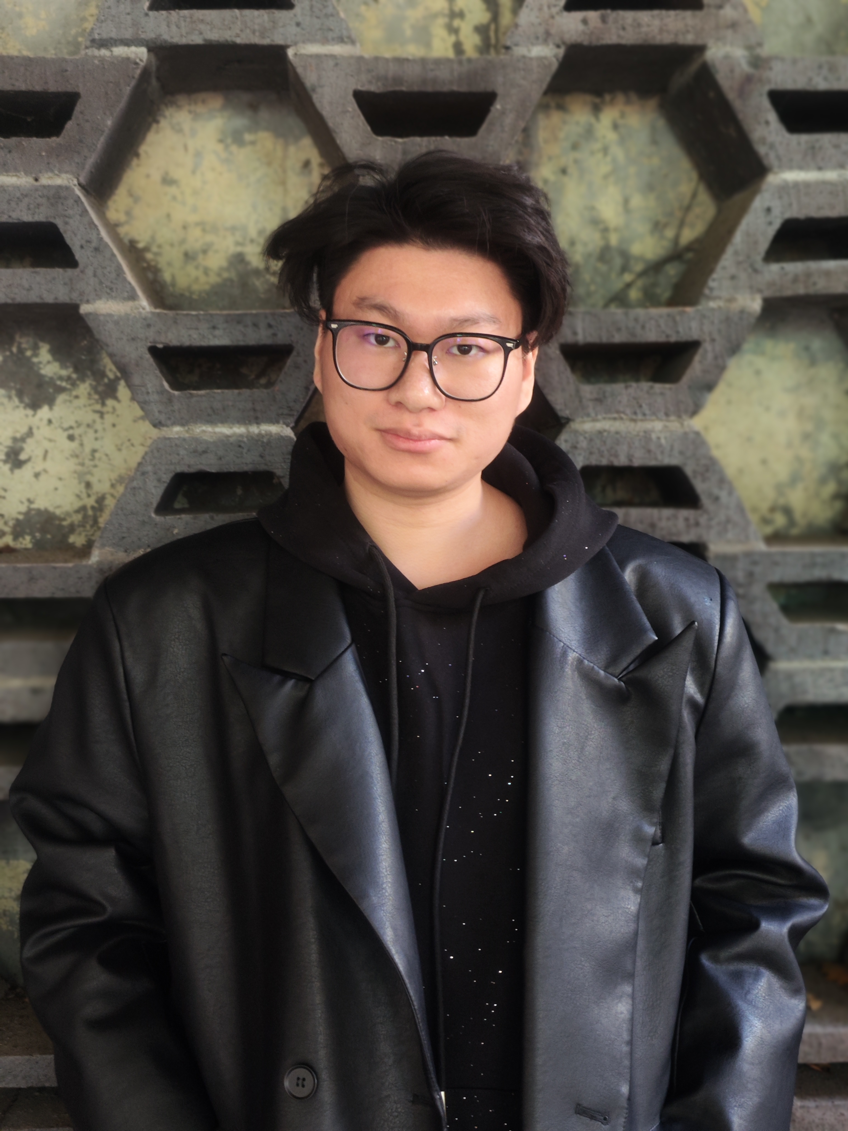

Slide 30
Visual Designer

Slide 31
An excellent painter

Slide 32
And then

Slide 33
Zhi Zhao

Slide 34
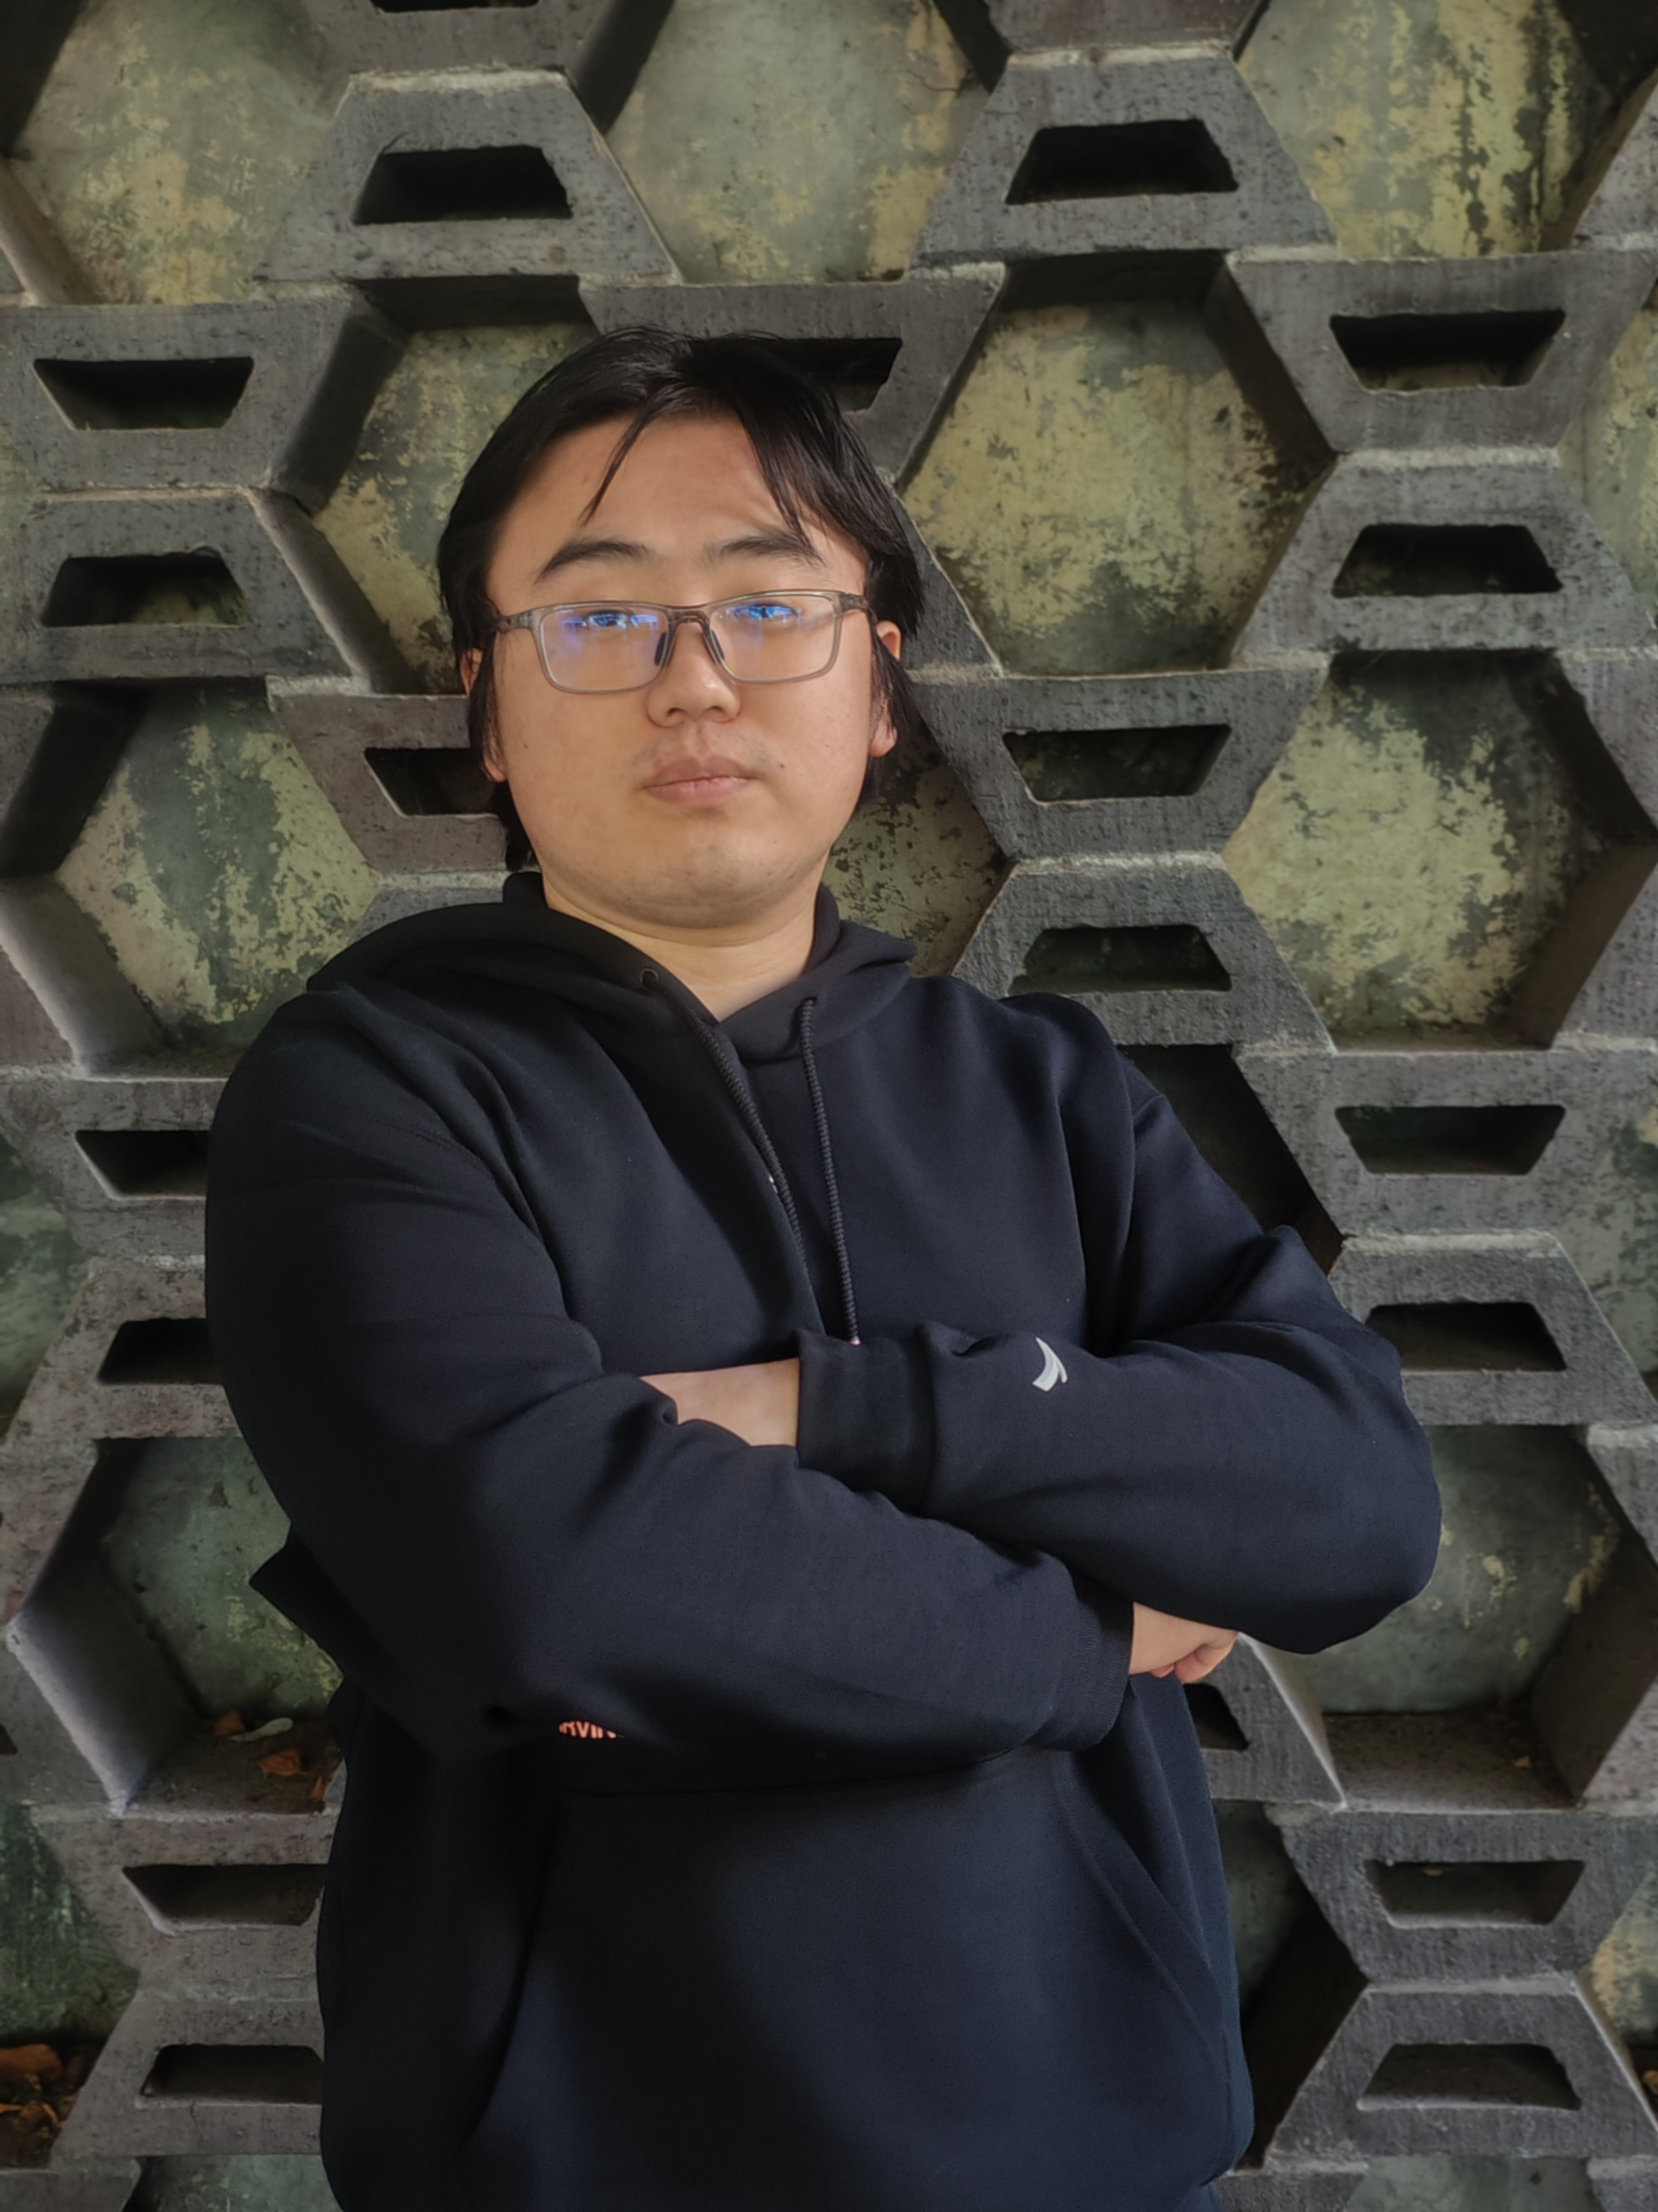

Slide 35
Developer

Slide 36
A thoughtful programmer

Slide 37
Besides

Slide 38
Yuying Zhang

Slide 39
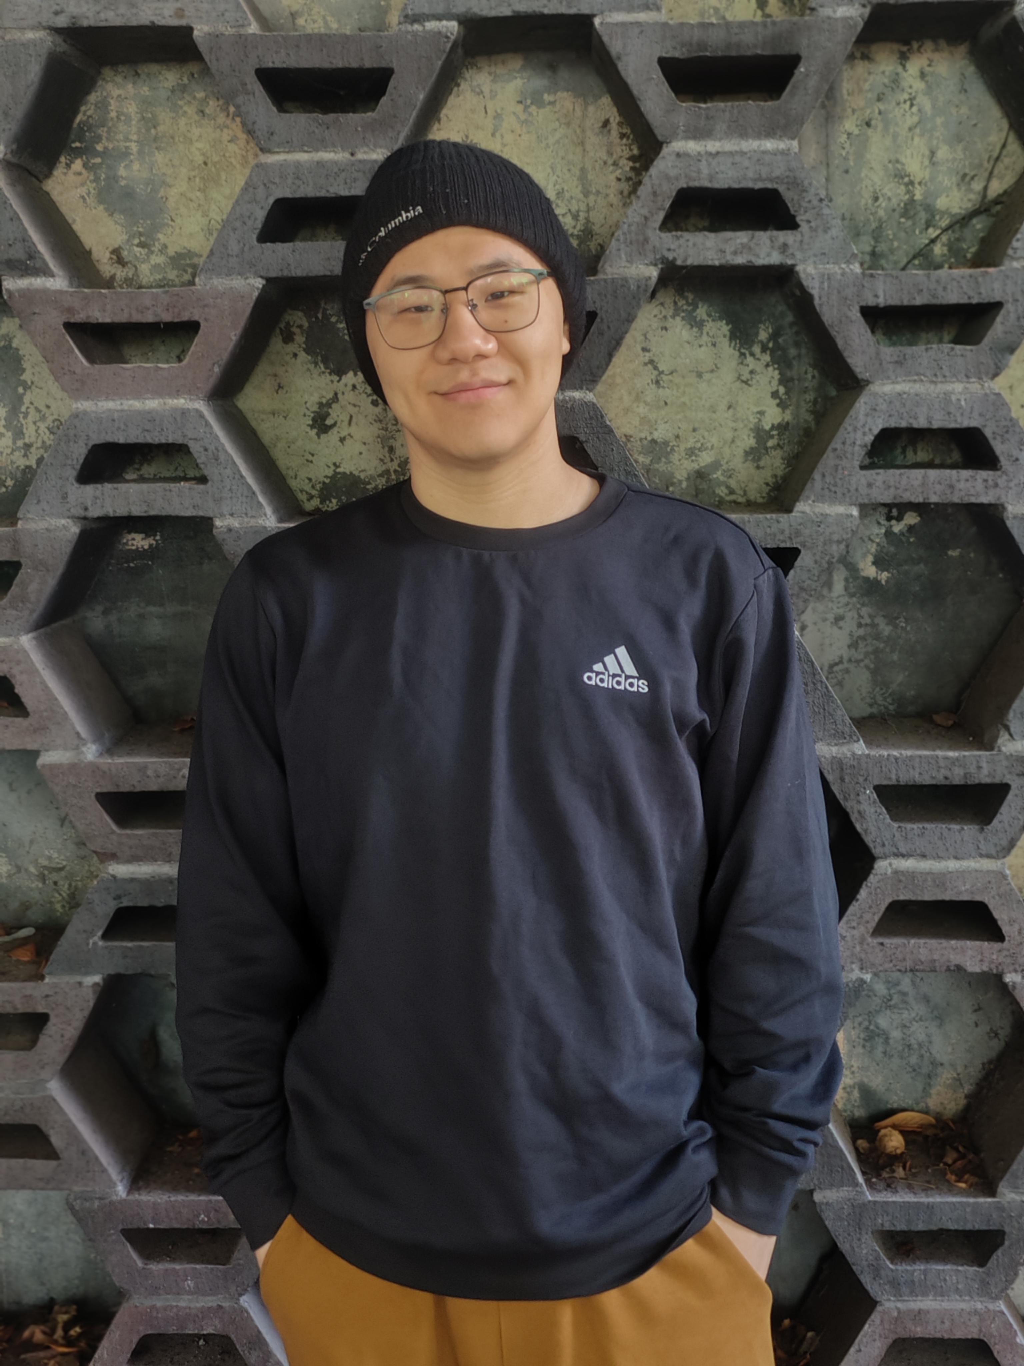

Slide 40
Copywriter

Slide 41
A diligent assistant

Slide 42
Finally

Slide 43
Kaijie Xu

Slide 44
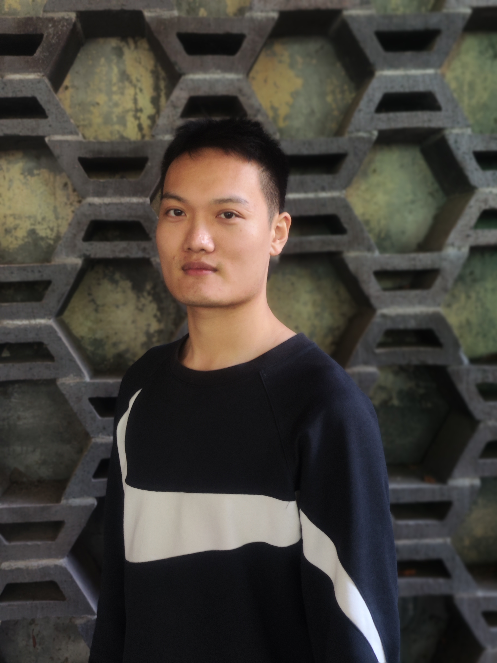

Slide 45
Project Manager

Slide 46
A charismatic dispatcher

